Slide 1







ROSSMAN STORES ANALYSIS
Ubong Udoette
5-08-2024

Slide 2



OUTLINE
Executive Summary
Introduction
Methodology
Results
Visualization – Charts
Dashboard
Discussion
Findings & Implications
Conclusion
Appendix

Slide 3

EXECUTIVE SUMMARY
Summary of Total sales from year 2013-2015
Total sales made during on/off promotion.
Impact of school holiday on sales
Impact of public holiday on sales
Outstanding sales by stores in between 2013-2015
Bottom sales by stores from 2013-2015
Recommendations

Slide 4

INTRODUCTION
Rossmann operates 1,115 drug stores located across Germany. Store sales are influenced by many factors, including promotions, school and state holidays.
This analysis aim to uncover the impact on sales by the above-mentioned factors with focus on promotion, school and state holidays.
The dataset records over 1 million entries from 2013-2015

Slide 5

METHODOLOGY
Date source: https://www.kaggle.com/competitions/rossmann-store-sales
Data Cleaning: The data has been thoroughly cleaned and wrangled with Python, Matplotlib and Seaborn to ensure correctness.
Exploratory Analysis: The data has been explored to gain induced insights and also validate the correctness and reliability of the outcome. Tools like Python and Power BI were used in this process
Visualization Tool: Finally, the dashboard embedding of various visualizations was created with Power BI

Slide 6
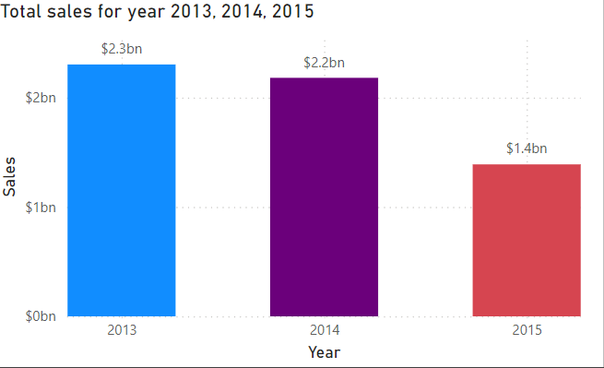
Total Sales for year 2013, 2014, 2015
Here we can see the slight decrease in total sales in year 2014, and tremendous one in 2015.
More insight is given in the discussion section.

Slide 7
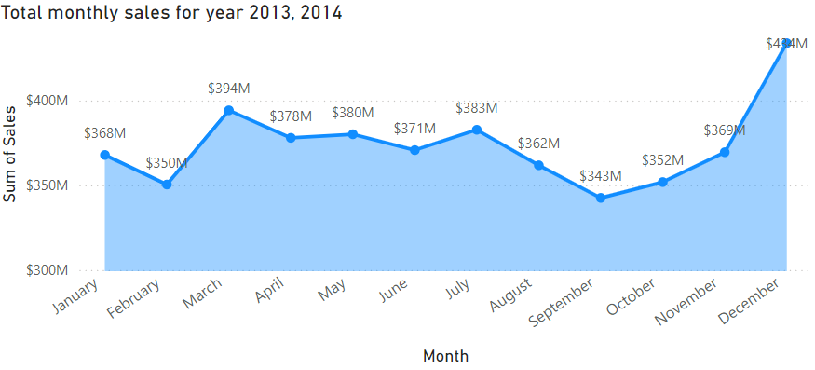
MONTHLY SALES TREND 2013-2014
Year 2015 omitted due to incomplete data
*note the spike in March, July and December.

Slide 8
Sales Trend
Findings:
The tremendous decrease in 2015 is as a result of incomplete data for the year 2015. Year 2015 was the current date for which the data collection was made. The data for this year runs from January to July only.
The slight decrease for year 2014 is from analysis, possible factors includes number of closed stores daily across the year, number stores in promotion and average sales . More insight will be given in the discussion slide.

Slide 9
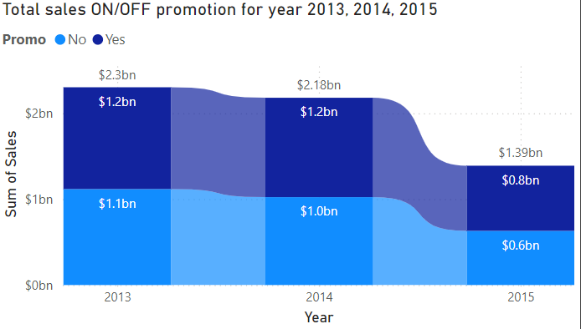
Sales Trend On/Off promotion

Slide 10
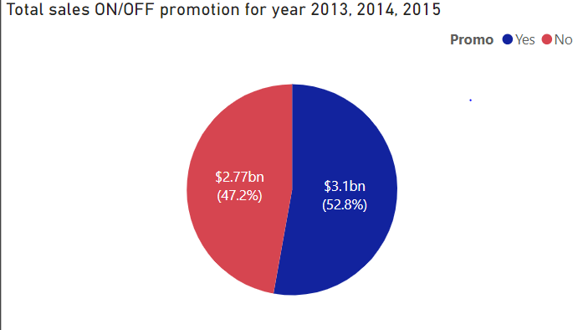
General overview of sales on/off promotion
Findings:
It is clear that in each year, sales made through promotion were higher than sales made off promotion.
In general, promotion contributed more sales in the years in review

Slide 11
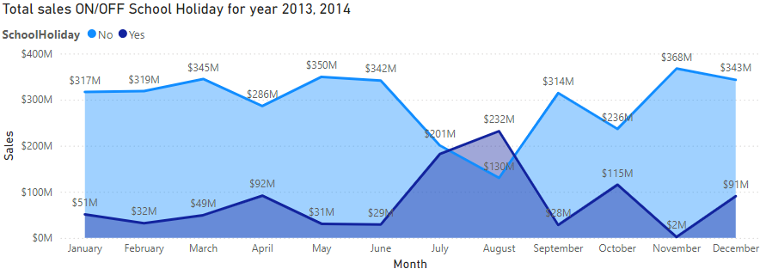
Sales trend on/ff Public School Holiday
Note the spike in April, August and October.

Slide 12
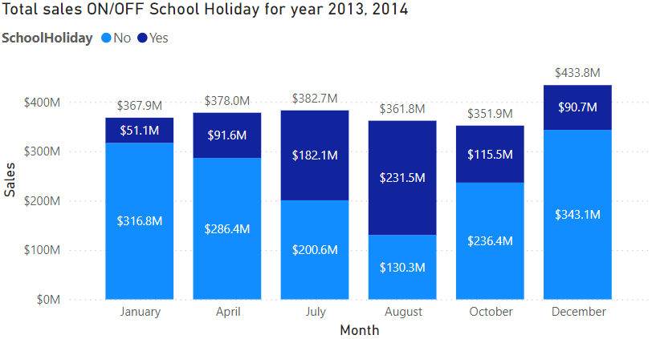
Sales Contribution on/off Public School Holiday
Note:
Months with very little or no sales on Holiday are omitted

Slide 13
Impact on sales on/off School Holiday
Findings:
From the analysis above, we can see that school holiday has a positive impact on sales. With the month of August being the highest.
Research confirms that during vacations, parents do take this period to vaccinate their children which in turn yield more sales on drugs sales.
You can see a shorter spike during April, which points out the Easter break, and July and August the long vacation period.
In general promotions during Holiday is also a factor for increase in sales during holidays.

Slide 14
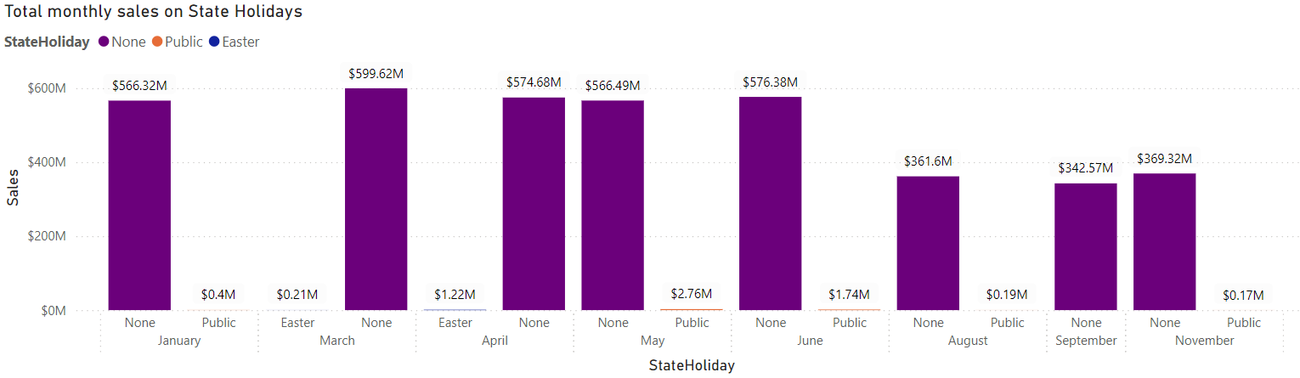
Impact on sales on/off State Holiday

Slide 15
Impact on sales on/off School Holiday
Findings:
The analysis shows that state holidays have very little impact on sales. Infact, the effect is negligible.
Sales during state holidays were very little compared to sales during not state holidays defined as “None” from the visualisation.

Slide 16
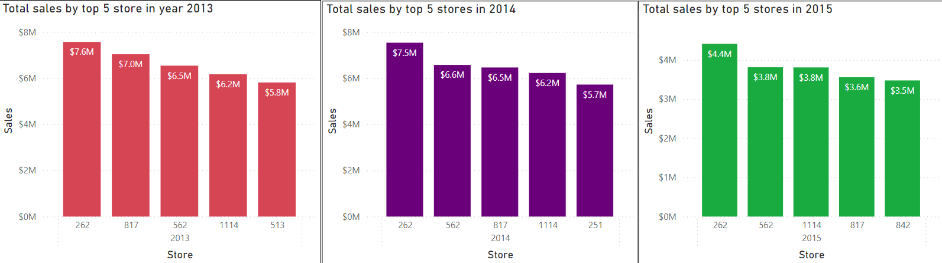
Top 5 stores in year 2013, 2014, 2015

Slide 17
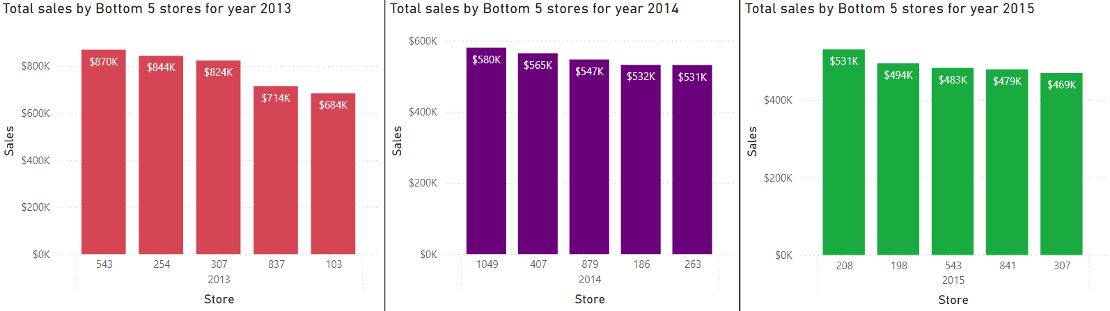
Top 5 bottom store in year 2013,2014,2015

Slide 18
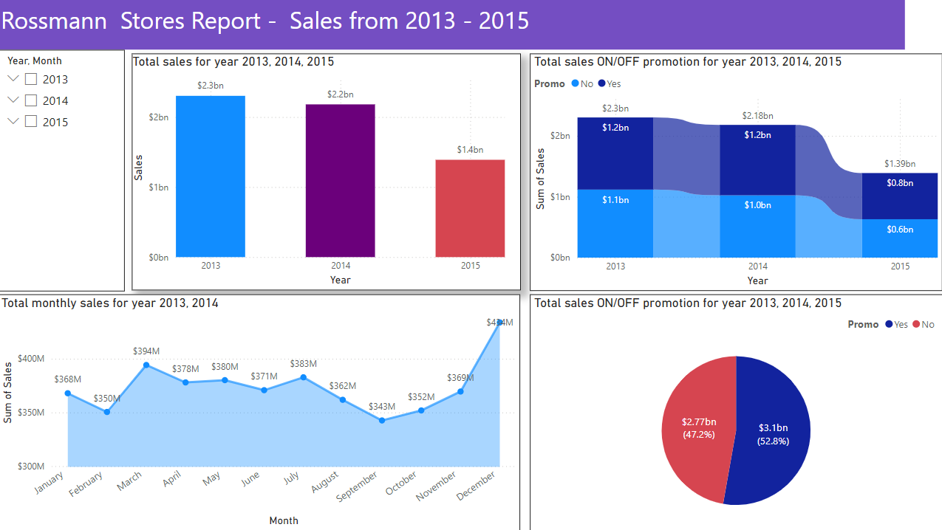
DASHBOARD TAB 1

Slide 19
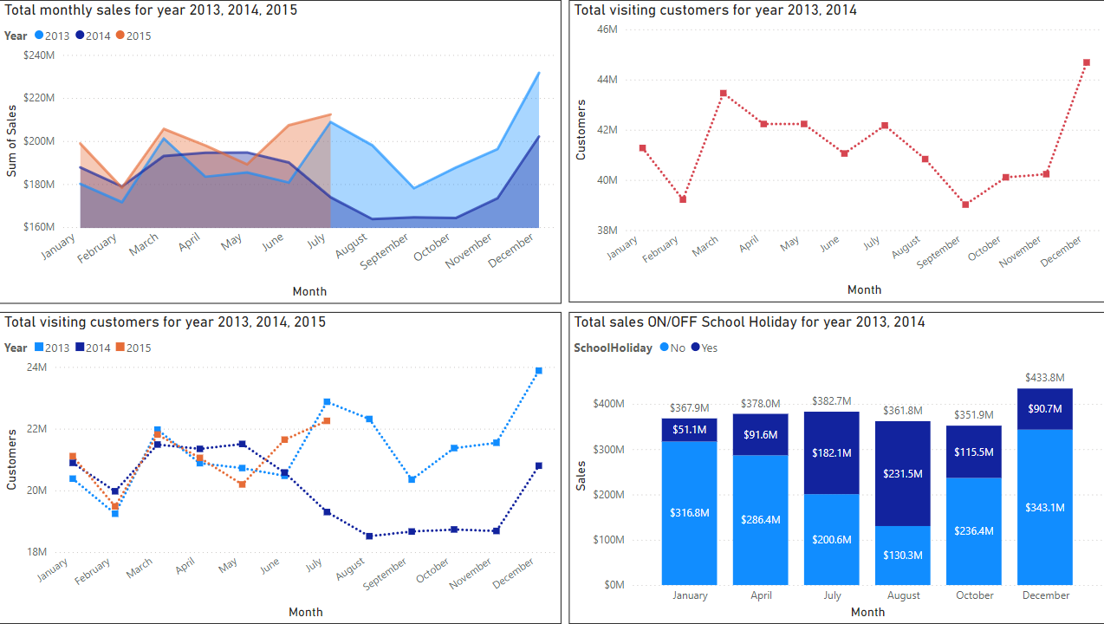
DASHBOARD TAB 2

Slide 20
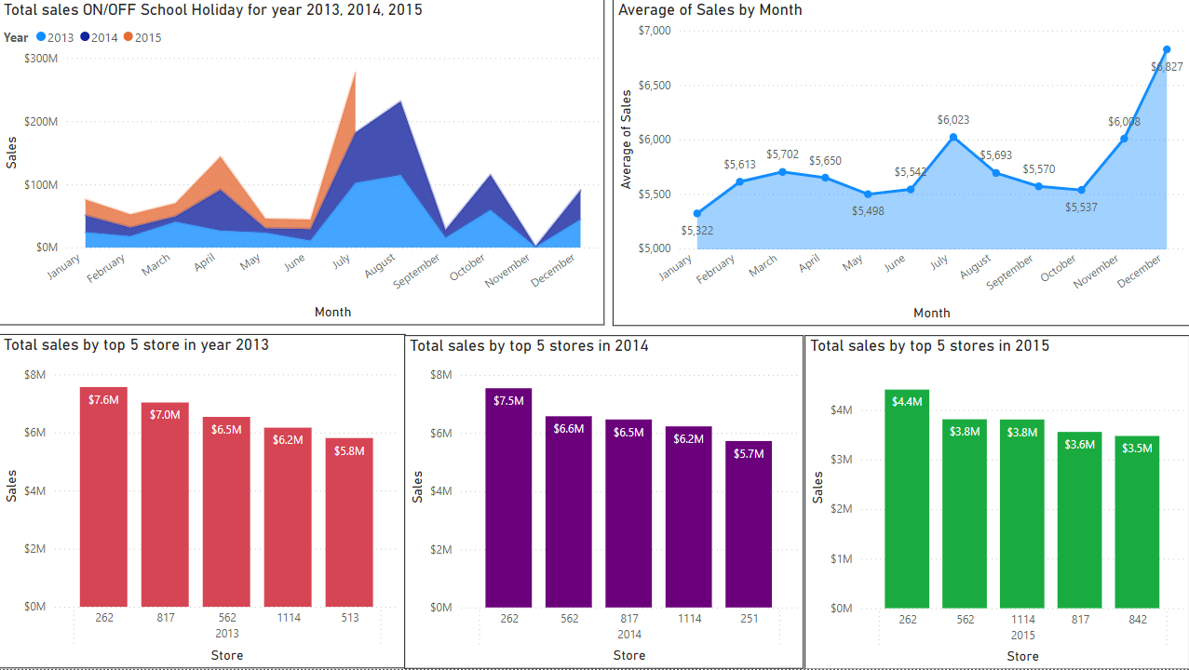
DASHBOARD TAB 3

Slide 21
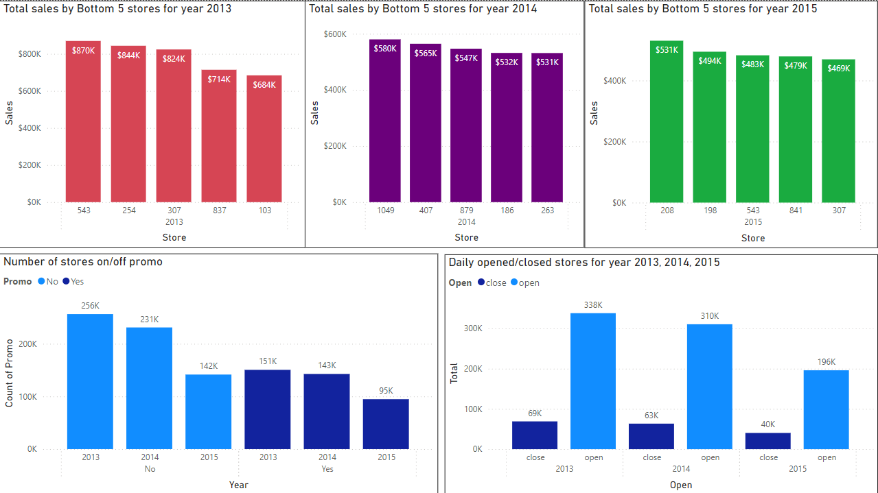
DASHBOARD TAB 4

Slide 22
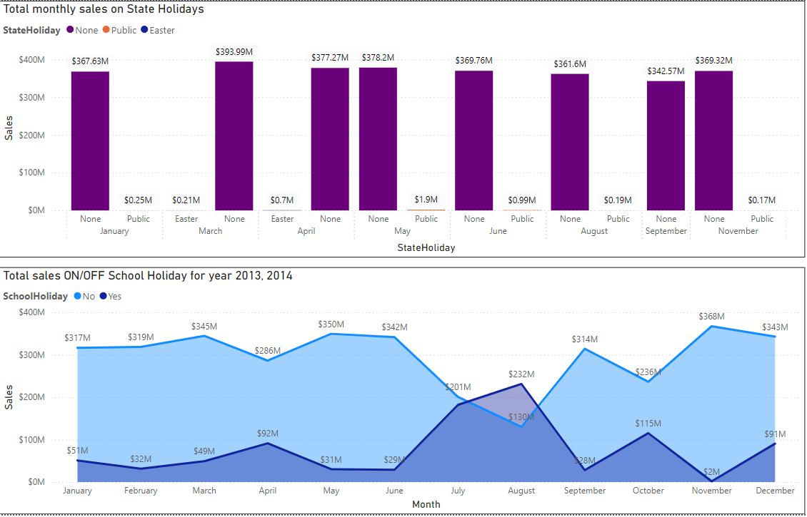
DASHBOARD TAB 5

Slide 23
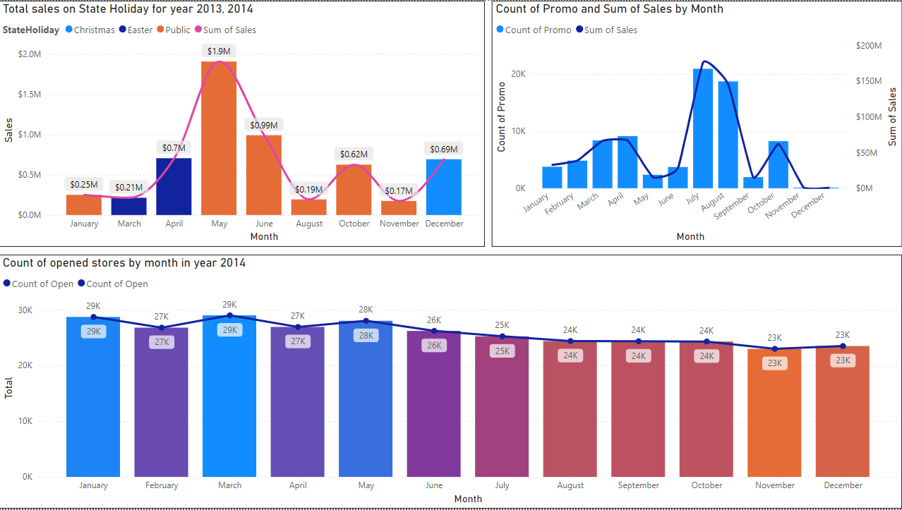
DASHBOARD TAB 6

Slide 24

DISCUSSION & Other Findings
Finding on the decrease in total sales in year 2014? Page 18, figure 1.
Findings on flat sale in year 2014 between August and November? Page 19, figure 1.
Why is there a spike in the month of April, July-August & October? Page 20, figure 1

Slide 25
OVERALL FINDINGS & IMPLICATIONS
Implications
Implication 1
Implication 2
Implication 3

Slide 26

CONCLUSION
Point 1
Point 2
Point 3
Point 4

Slide 27

APPENDIX
Include any relevant additional charts, or tables that you may have created during the analysis phase.

